Slide 1
Welcome! PLC Facilitator’s Training
Day 2
Empowering Collaborative Teams

Slide 2
End In Mind
Notes:
Process activity: Examine KUD and Learning Scale.

Slide 3
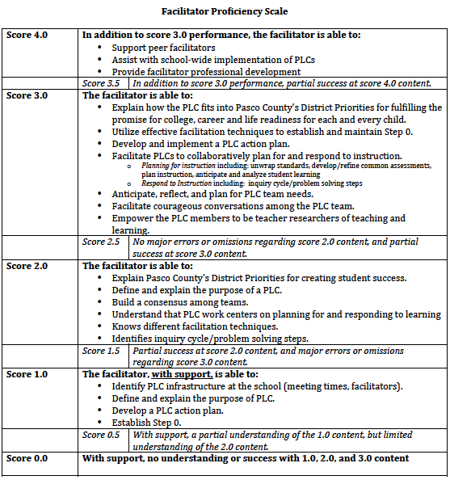
Notes:
Participants will complete a post self assessment at the end of the presentation

Slide 4
Norms for Our Work
If you think it, say it
Ask questions
Take care of your neighbor
Take care of yourself
What is said here stays here; what is learned here leaves here
Be present

Slide 5
PLC Facilitator’s Training Learning Map Goal for this Unit: Develop and Implement PLCs to support CCSS and Professional Growth
PLC Facilitator Training Day 1 | PLC Facilitator Training Day 2
Introduction and Background Pasco’s Multi-Year PLC Plan Connections to Objectives/Priorities and Mission/Values How PLC work integrates all district focus areas PLCs Definition of PLCs; Key Terms Purpose of PLC work 5 Questions that drive PLCs Inquiry Cycle Step 0 for PLCs PLC infrastructure planning Organization of Teams/Meeting Structures Norms/Roles Climate/Culture Scheduling/Protective Time Establishing and Communicating Clear Expectations Common Assessments/Assessment Mapping Effective Facilitation Techniques Characteristics of a Professional Facilitator | Review of Previous Work Purpose of PLC work Facilitation Techniques 5 questions that drive PLCs What do we want all students to learn? (Unwrapping Standards, Creating Learning Goals and Scales) How will we know if and when they’ve learned it? (Scales/Rubrics) How will we teach it? (Prioritized instructional practices, Marzano Connections, Prioritized Shifts) How will we respond if some students do not learn and how will we respond if some students have already learned? PLC Action Plan Development Step 0 with Grade/Content/Subject Teams 5 PLC Driving Questions with Grade/Content/Subject Teams Facilitator Support Plan

Slide 6
Day 2: Key Content and Activities
Review of Previous Content
5 Driving Questions for PLC Work
PLC Action Planning
Unit Learning Goal: Develop and implement PLCs to support
CCSS, Professional Learning, and Professional Growth
Today’s Learning Goals: Know and understand the 5 questions for PLCs and to develop PLC action plans
DQ #2: Identifying Critical Information

Slide 7
Getting Ready: Materials
Materials to Bring
Provided Materials
Day 1 PPT
PLC Note Taking Guide
Access to ELA and Math CCSS
PPT Handout
PLC Action Planning Handout

Slide 8
Review of Day 1 Content
DQ #3: Review Content

Slide 9
Pasco’s Integrated System: Why, What, and How
As a team –
Why are we moving towards an integrated system?
What will that system look like?
How will this be done?
Notes:
Team activity/discussion. Should be recall from day 1. Encourage participants to look back at their Day 1 ppt handout. Do not take longer than 10 minutes

Slide 10
Review of Content: True or False
Professional Learning Communities are focused on learning.
Step “0” are things that we need to address before we engage in collaborative planning.
PLCs are time in which teams problem-solve and/or use the inquiry process and talk about at-risk students.
Notes:
Give teams 2-3 minutes to gain consensus and share responses.

Slide 11
Activity: Developing a Communication Plan
“The problem with communication is the illusion that is has occurred”
George Bernard Shaw
Develop a communication plan for your Step 0 action plan. Include the following components:
Who are the stakeholders?
What should be communicated?
When should it be communicated?
How should it be communicated?

Slide 12
Sample Communication Format
Review background and compelling whys
-What is your compelling why for your Step 0 work?
Discuss who was involved in the work
Identify required outcomes (if any)
Identify desired outcomes
-Implementation of CCSS
-Guaranteed and Viable Curriculum
Discuss key decisions that were made
-Meeting structures
-Schedules
-Any other Step 0 Action Plans
Discuss how these key decisions meet desired outcomes
Discuss potential risks, and risks will be minimalized
Q and A.
Adapted from TregoED Forum
Notes:
Have selected teams share their communication plan. Have another team listen to the plan for the purpose of asking a question.

Slide 13
“The illiterate of the 21st century will not be those who cannot read and write, but those who cannot learn, unlearn and relearn.”
- Alvin Toffler
Notes:
This is a transition to common core standards. As we talk about PLCs and the work that PLCs will engage in, we need to think about how CCSS changes some of our conversations. Some of the conversation stays the same, we focus on standards. However, as the standards change, it has implications for the entire system.

Slide 14
Common Core = A New 21st Century Learner
Notes:
The standards are a result of working backwards. Previous standards started with K and moved from there. The CCSS starts with what the businesses need for their staff, and worked back from there.

Slide 15
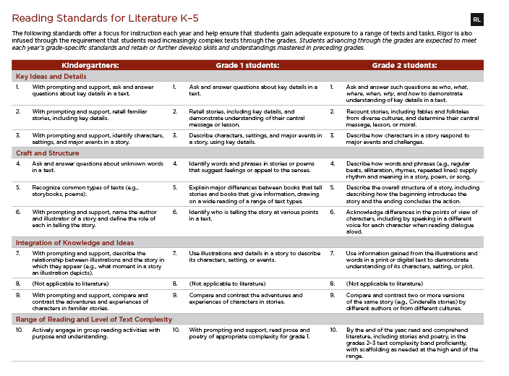
What are the CCSS?
“The Common Core State Standards provide a consistent, clear understanding of what students are expected to learn. The standards are designed to be robust and relevant to the real world, reflecting the knowledge and skills that our young people need for success in college and careers.”
The CCSS have been adopted by 45 of the 50 states.
They can be found at the following link: http://www.corestandards.org/
*Adapted from Building a Bridge Between Common Core and the Art and Science of Teaching Framework

Slide 16
5 Driving Questions for Professional Learning Communities (PLC)
Unit Learning Goal: Develop and implement PLCs to support CCSS, Professional Learning, and Professional Growth
Mini-Lesson Goal: To understand the 5 driving questions for PLCs
DQ #1: Communicating Learning Goals and Feedback

Slide 17
“The fact that teachers collaborate will do nothing to improve a school. The purpose of collaboration can only be accomplished if the professionals engaged in collaboration are focused on the right things.” ~Richard DuFour
What does collaboration look like with your team/at your school? What would we hear and see? What type of work is your team engaged in?
Notes:
Teams that worked on the step 0 pieces of clarifying the work that teams should accomplish should have more done here.

Slide 18
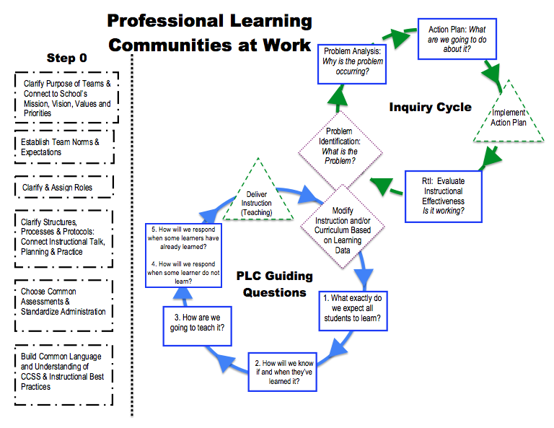
The “Right” Work
Notes:
Planning for Learning vs. Responding to learning

Slide 19
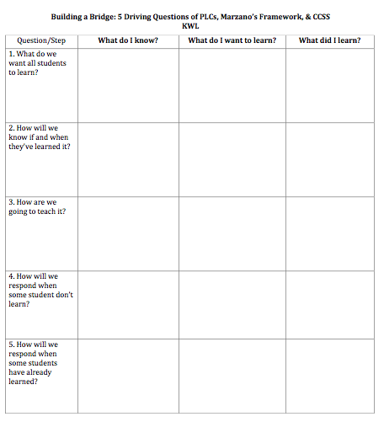
Activating New Learning
Directions:
Independently complete Question #1 “What do I know?” and “What do I want to learn?”

Slide 20
5 Driving PLC Questions
What do we want all students to learn?
Unwrap Standards (K-U-D)
Use K-U-D to develop learning scales and goals
How will we know if and when they’ve learned it?
Use learning scales and other assessments to track and monitor student progress (formative and summative assessments)
How are we going to teach it?
Based upon learning scale, decide the type of lesson that will best facilitate student mastery of content (e.g., introducing new knowledge, deepening knowledge, or generating and testing hypotheses)
Select instructional strategies that will maximize student learning
(Marzano’s 41 elements)
How will we respond when some students don’t learn?
Anticipate and plan for needs of at-risk students
How will we respond when some students have already learned?
Anticipate and plan for needs of students who need acceleration

Slide 21
PLC Question 1: What do we want all students to learn?
Unwrapping CCSS
Creating Learning Scales

Slide 22
The “Right” Work
Start Here!
Notes:
Planning for Learning vs. Responding to learning

Slide 23
Why Unwrapping the Common Core Standard within PLCs?
http://cooperativelearning.nuvvo.com/lesson/9592-seinfeld-teaches-history
http://www.teachertube.com:8809/viewVideo.php?video_id=241598
DQ2: Interacting with New Knowledge
Notes:
Video Clip: Seinfeld teachers history
Discussion question on the next slide: Why do you think it is important to unwrap the common core standards as a collaborative PLC team? What are some benefits for improving teaching practices and student achievement?

Slide 24
Why do you think it is important to unwrap the common core standards as a collaborative PLC team? What are some benefits for improving teaching practices and student achievement?
Notes:
TTYP
What do we know now? How do we think what we learn today will clarify our learning?

Slide 25
Why Unwrap the Common Core Standards?
“Guaranteed and viable curriculum gives students access to the same essential learning regardless of who is teaching the class and each member of the team will work to ensure every student acquires the knowledge and skills the team has agreed are most essential for that unit." (Marzano, 2003)
“GUARANTEED & VIABLE CURRICULUM”
NUMBER ONE FACTOR that increases levels of learning -Marzano; Porter; Lezotte
DQ2: Identifying Critical Information
Notes:
viable and guaranteed curriculum
during a unit presented within a specific time allotted (e.g., 6 weeks) each member of the team will work to ensure every student acquires this essential knowledge

Slide 26
Unwrapping Standards
“Unwrapped standards provide clarity as to what students must know and be able to do. When teachers take the time to analyze each standard and identify its essential concepts and skills, the result is more effective instructional planning, assessment and student learning.”
Ainsworth, L. (2003). Unwrapping the standards: A simple process to make standards manageable. Englewood, CO: Lead + Learn Press.

Slide 27
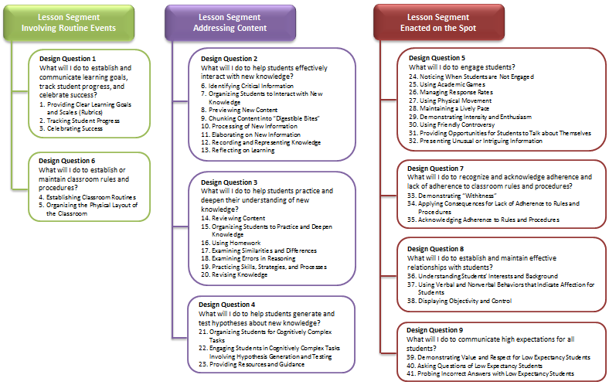
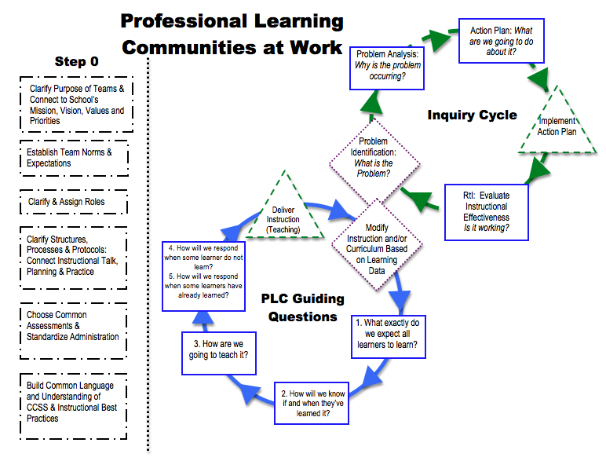
Starting Point for PLC teams
Unwrap CCSS
Question 1: What do we want all students to learn?
Learning Scale/Goal
Question 2: How do we know if and when they’ve learned it?
Identify and Cluster Common Core Standards for Unit Planning
Assessment
Question 3: How are we going to teach it?
Lesson Segments
(District Work)
Daily Lessons
Question 4/5: How will we respond when some students don’t learn? How do we respond when some students have already learned?
Reflect/Respond
Notes:
Connector Slide

Slide 28
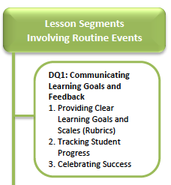
PLC Question 1: What do we want all students to learn?
Unwrap Standards
Identify prioritized standard(s)
Identify what students need to be able Know, Understand, and Do and make connections to declarative and procedural knowledge
Identify pre-requisite skills needed for KUD
Develop a Scale
Use K-U-D to develop a scale that represents increased levels of cognitive complexity (make sure that the scale matches desired taxonomy)
Use scale to develop student friendly learning goals/essential questions
Desired Outcomes: Students will be able to explain what they are learning and why based upon learning goals and scales.

Slide 29
A note about Content vs. Process
The focus of this training is on the process of PLCs
Content is also important, and will be critical for your PLC, but our goal is to teach the process
Specific content (CCSS and Marzano) will be light for illustration purposes

Slide 30
PLC Question 1: What do we want all students to learn?
Unwrap Standards
Identify prioritized standard(s)
Identify what students need to be able Know, Understand, and Do and make connections to declarative and procedural knowledge
Identify pre-requisite skills needed for KUD
Develop a Scale
Use K-U-D to develop a scale that represents increased levels of cognitive complexity (make sure that the scale matches desired taxonomy)
Use scale to develop student friendly learning goals/essential questions
Desired Outcomes: Students will be able to explain what they are learning and why based upon learning goals and scales.

Slide 31
What Tools In Our Toolbox are Available?
Materials:
Common Core State Standards
Vertical Articulation of Grade Level Standards
Curriculum Maps (if available)
Test Specifications (if available)
PARCC Assessments (samples)
Helpful Websites:
http://www.corestandards.org/
http://dpi.state.nc.us/acre/standards/common core-tools/#unela
http://www.engageny.org/common-core-curriculum

Slide 32
Example Step 1: Identify prioritized standard(s)
PLC.0.0.2 – Participants will plan to facilitate Step 0 components with PLC teams

Slide 33
Vertical Progression of Standards
Measurement and Data (MD)
Grade | PLC.0.0.3 - Participants will…
Grade | PLC.0.0.2 – Participants will plan to facilitate Step 0 components with PLC teams
Grade | PLC.0.0.1 – Participants will…

Slide 34
PLC Question 1: What do we want all students to learn?
Unwrap Standards
Identify prioritized standard(s)
Identify what students need to be able Know, Understand, and Do and make connections to declarative and procedural knowledge
Identify pre-requisite skills needed for KUD
Develop a Scale
Use K-U-D to develop a scale that represents increased levels of cognitive complexity (make sure that the scale matches desired taxonomy)
Use scale to develop student friendly learning goals/essential questions
Desired Outcomes: Students will be able to explain what they are learning and why based upon learning goals and scales.

Slide 35
What do we mean by Know, Understand, and Do?
When collaborative planning, some standards will work well together to form a lesson/unit of instruction.
What are those prioritized standards?
Supplemental Standards (Speaking & Listening, Language)?
What do students need to be able to know, understand, and do to demonstrate mastery of prioritized standards?
Know (Vocabulary, Facts, Formulas, Definitions)-Procedural/Declarative
Understand (Big Ideas, Core Principles, Generalizations, Real-World Connections)-Declarative
Do (Skills)-Procedural
K-U-D is completed before each unit prior to planning lessons and activities.

Slide 36
Two Types of Knowledge
Declarative
(Information)
Students will know the formula for division (basic)
Students will understand division as an unknown factor problem (higher level)
Procedural (Skills, Strategies, Processes)
Student will be able to Fluently multiply and divide within 100
(3.0A.7)
Know
Understand
Do

Slide 37
Step 2: Determine Vocabulary, Facts, Formulas, Definitions
Step 3: Determine Big Ideas, Core Principles, Generalizations
Step 1: Start with Standards
Step 4: Identify Skills
“Verbs”
Standard (Grade Level) | Know (Declarative/Procedural) | Understand (Declarative) | Do (Procedural)
PLC.0.0.2 – Participants will plan to facilitate Step 0 components with PLC teams | Organization of Team Schedule for Meetings Consensus Techniques Norms Roles PLC Key Vocabulary Facilitation Techniques Where their team is on Step 0 | Impact of Step 0 components on effectiveness of PLCs Impact of facilitation techniques on Step 0 Importance of Reflecting on PLC work | Anticipate barriers and plan step 0 to minimize barriers Identify Step 0 content that will be addressed during first few PLC meetings Identify what techniques that will utilized to address step 0
Notes:
Mention circling verbs and nouns as a protocol for this process

Slide 38
PLC Question 1: What do we want all students to learn?
Unwrap Standards
Identify prioritized standard(s)
Identify what students need to be able Know, Understand, and Do and make connections to declarative and procedural knowledge
Identify pre-requisite skills needed for KUD
Develop a Scale
Use K-U-D to develop a scale that represents increased levels of cognitive complexity (make sure that the scale matches desired taxonomy)
Use scale to develop student friendly learning goals/essential questions
Desired Outcomes: Students will be able to explain what they are learning and why based upon learning goals and scales.

Slide 39
Step 3: What prior knowledge do students need to be successful with the grade level standard?
Grade
Grade | PLC.0.0.2 – Participants will plan to facilitate Step 0 components with PLC teams
Grade
What essential learning is required for mastery ?
Notes:
Have teams process this question (as it relates to our example standard: PLC.0.0.2 – Participants will plan to facilitate Step 0 components with PLC teams
The pre-requisites are noted on the next slide (See Step 3).

Slide 40
Unwrapping Standards
Standard: PLC.0.0.2 – Participants will plan to facilitate Step 0 components with PLC teams
Know (facts/vocabulary) | Understand (Concepts) |  | Do (skills)
Organization of Team Schedule for Meetings Consensus Techniques Norms Roles PLC Key Vocabulary Facilitation Techniques Where their team is on Step 0 | Impact of Step 0 components on effectiveness of PLCs Impact of facilitation techniques on Step 0 Importance of Reflecting on PLC work |  | Anticipate barriers and plan step 0 to minimize barriers Identify Step 0 content that will be addressed during first few PLC meetings Identify what techniques that will utilized to address step 0
What prior knowledge do students need to be successful with this standard?
Key Characteristics: Growth mindset Well respected, organized and dependable Will support the vision and mission of the school Acts and views themselves as a professional educator Ability to be and potentially already in a faculty leadership position |  | Beliefs: All students and staff can learn Power of Collaboration Decisions are best made with data Teams can learn and grown and will persevere
Step 1: Identify prioritized standard(s)
Step 2: Unwrap Standards (Know, Understand, Do)
Step 3: Determine pre-requisite skills required
Notes:
This is a start…have participants add to this and provide suggestions as needed…
Note: Prerequisite skills were taken right from the top section of the K-U-D titled Key Characteristics and Beliefs

Slide 41
Unwrapping Standards: Team Practice
Steps 1, 2, & 3

Slide 42
Unwrapping Standards Activity: Team Practice
Pre-Selected Standards
Prep/Decisions:
Remember roles (time keeper, note taker, facilitator)
Select an option below:
Option #1: Select 1 of the 2 pre-selected standards provided (either math or ELA) for the entire group to unwrap.
Option #2: Break into smaller groups. 1 group unwraps ELA standard, 1 group unwraps Math standard.
Locate your standards for unwrapping in your Participants Notebook.
Level | ELA | Math
High | RL.9-10.1 | HSA-CED.A.1
Middle | RL.7.1 | 7.RP.A.1
Elementary | RL.1.1 | 2.OA.B.2
Notes:
ELA Standard 1-Key Ideas and Details
RL.1.1-1st grade
RL.7.1-7th grade
RL.9-10.1-9th and 10th grade
Math
HSA-CED.A.1: High School Algebra I (Creating Equations)
7.RP.A.A: 7th grade (Ratios and Proportional Relationships)
2.OA.B.2: 2nd grade (Operations & Algebraic Thinking)

Slide 43
Unwrapping Standards Activity: Team Practice
Steps for Unwrapping Standards:
Identify prioritized standard(s)
Identify what students need to be able Know, Understand and Do (K-U-D) and make connections to declarative and procedural knowledge
Determine pre-requisite skills for standard
Notes:
Encourage teams to utilize resources and technology as appropriate

Slide 44
Unwrapping Standards
Standard:
Know (facts/vocabulary) | Understand (Concepts) |  | Do (skills)
What prior knowledge do students need to be successful with this standard?
Step 1: Identify prioritized standard(s)
Step 2: Unwrap Standards (Know, Understand, Do)
Step 3: Determine pre-requisite skills required

Slide 45
Team Reflection
How was the unwrapping standards process?
How well did your team work together while unwrapping standards?
Were your norms and roles helpful with collaboration?
What obstacles did your team overcome? What can you celebrate?
What components of this process can you begin to implement in future planning?

Slide 46
PLC Video Reflection
Step 1, 2, 3
unwrapping Standards
There are many different ways to unwrap standards. What are some similarities and/or differences that you noticed about how this team unwrapped standards?
How does this compare to the work at your school?
http://www.youtube.com/watch?v=WXdH5amlaM4
Notes:
The real work for the video starts at around 4minutes.

Slide 47
PLC Question 1: What do we want all students to learn?
Unwrap Standards
Identify prioritized standard(s)
Identify what students need to be able Know, Understand, and Do and make connections to declarative and procedural knowledge
Identify pre-requisite skills needed for KUD
Develop a Scale
Use K-U-D to develop a scale that represents increased levels of cognitive complexity (make sure that the scale matches desired taxonomy)
Use scale to develop student friendly learning goals/essential questions
Desired Outcomes: Students will be able to explain what they are learning and why based upon learning goals and scales.

Slide 48
A scale: What’s the point?
A scale:
Articulates distinct levels of knowledge and skills relative to a specific topic
Provides a roadmap for designing instruction that reflects a progression of learning and authentic assessment.
Allows students to know how they are doing and how to get better-motivating!

Slide 49
Step 4: Use K-U-D to create a learning scale
Know | Understand | Do
Organization of Team Schedule for Meetings Consensus Techniques Norms Roles PLC Key Vocabulary Facilitation Techniques Where their team is on Step 0 | Impact of Step 0 components on effectiveness of PLCs Impact of facilitation techniques on Step 0 Importance of Reflecting on PLC work | Anticipate barriers and plan step 0 to minimize barriers Identify Step 0 content that will be addressed during first few PLC meetings Identify what techniques that will utilized to address step 0

Slide 50
Step 4: Use K-U-D to develop a learning scale
Know
Level 1 (with help and support)
(basic declarative and procedural knowledge)
-Facts
-Vocabulary
-Definitions
-Formulas
Pre-requisite skills
Level 2 (Simpler Stuff)
DQ2
Understand
-Big Ideas
-Core Principles Generalizations
-Real-World Connections & Application)
Level 3 (Grade Level Standard)
DQ3
Level 4 (More Complex)
Do
Skill (verbs)
DQ4

Slide 51
Step 4: Example
Know (facts/vocabulary) | Understand (Concepts) | Do (skills)
Organization of Team Schedule for Meetings Consensus Techniques Norms Roles PLC Key Vocabulary Facilitation Techniques Where their team is on Step 0 | Impact of Step 0 components on effectiveness of PLCs Impact of facilitation techniques on Step 0 Importance of Reflecting on PLC work | Anticipate barriers and plan step 0 to minimize barriers Identify Step 0 content that will be addressed during first few PLC meetings Identify what techniques that will utilized to address step 0
Score 0: | Score 1.0: | Score 2.0: | Score 3.0: (Leaning goal) | Score 4.0: (more complex)
Even with help, no understanding or skill demonstrated. | The facilitator, with support, is able to: Identify PLC infrastructure at the school (meeting times, facilitators). | Participants will recall the organization of their team Participants will identify norms and roles Participants will know facilitation and consensus techniques | Participants will plan to facilitate Step 0 components with PLC teams. Plans include specific content to be covered, and techniques in which the content will be covered | Participants will incorporate feedback and reflect to continue to work on Step 0 components Participants will consult with other facilitators to support their Step 0 work
DQ2
DQ3
DQ4

Slide 52
Step 5: Develop student friendly learning goal/essential question
Standard: PLC.0.0.2 – Participants will plan to facilitate Step 0 components with PLC teams
Unit Learning Goal: How will I plan and facilitate Step 0 components with PLC teams?

Slide 53
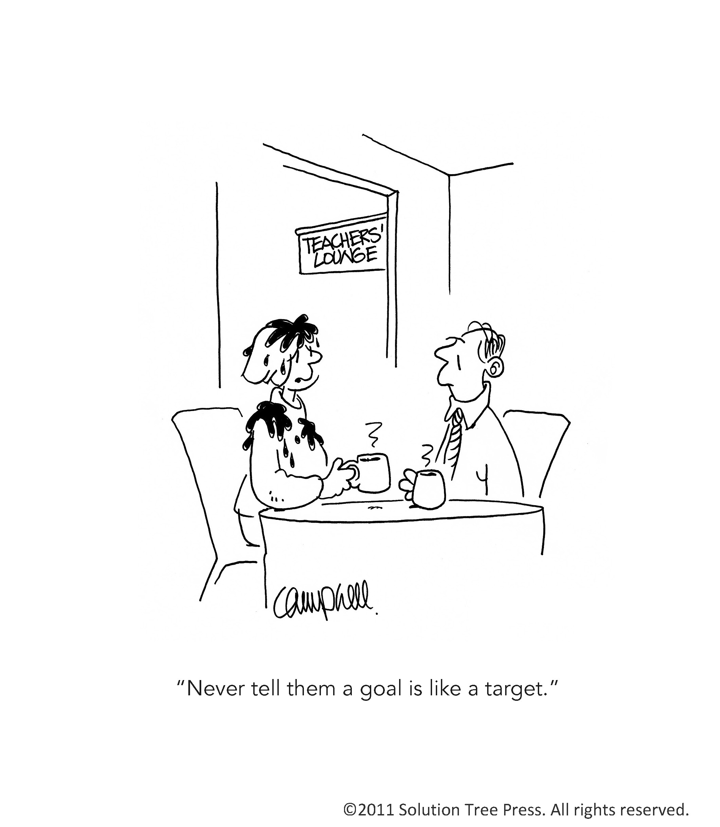

Slide 54
Unwrapping Standards: Team Practice
Steps 4 & 5
Notes:
This activity is optional depending on how far the teams get on the first activity.

Slide 55
Activity: Team Practice
Remember roles (note taker, facilitator, time keeper)
Use K-U-D to develop learning scale
Determine taxonomy of learning scale
Notes:
This activity is optional depending on how far the teams get on the first activity.

Slide 56
Complete Scale
Assessments for Learning Example
Score 0: | Score 1.0: | Score 2.0: | Score 3.0: (Leaning goal) | Score 4.0: (more complex)
Assessment Methods
Time of Assessment
Complexity/Rigor of Task
Notes:
Participants should complete only the scale section

Slide 57
Team Reflection
How was the scale development process (with taxonomy)?
How well did your team work together?
Were your norms and roles helpful with collaboration?
What obstacles did your team overcome? What can you celebrate?
What components of this process can you begin to implement in future planning?
Notes:
This activity is optional depending on how far the teams get on the first activity.

Slide 58
Activating New Learning
Directions:
Independently complete Question #1 “ What did I learn?” Then Share your thoughts with your processing partner.
Notes:
Have participants keep their KWLs out because they will complete the section for Question #2 very soon.

Slide 59
PLC Question 2: How do we know if and when they’ve learned it?
Align Learning Scales to Assessment
Assessment of Learning
Assessment for Learning

Slide 60
The “Right” Work
Notes:
Planning for Learning vs. Responding to learning

Slide 61
Activating New Learning
Directions:
Independently complete Question #2 “What do I know?” and “What do I want to learn?”

Slide 62
Starting Point for PLC teams
Unwrap CCSS
Question 1: What do we want all students to learn?
Learning Scale/Goal
Question 2: How do we know if and when they’ve learned it?
Identify and Cluster Common Core Standards for Unit Planning
Assessment
Question 3: How are we going to teach it?
Lesson Segments
(District Work)
Daily Lessons
Question 4/5: How will we respond when some students don’t learn? How do we respond when some students have already learned?
Reflect/Respond

Slide 63
Question 2: “We taught it, did they get it?”
Timing (C-I-A)
Within our lesson, when and how are we going to assess for student learning ? How are we pre-planning for this?
- Ongoing and embedded in teaching (daily)
- Pre and Post learning (before and after instruction)
- Student Self- Assessment and Goal Setting w/ feedback Combination
When and how are we going to reflect on the lesson/unit and student learning?
What student data will you collect and bring to the meeting?
Notes:
Agreed upon teaching and learning
Assessment- Agreed upon pre knowledge to be assessed for each lesson/unit
Rigor- Related to cognitive demands to assess learning (to include homework and make-up work)

Slide 64
Question 2: “We taught it, did they get it?”
Questions to Consider
What skills do we prioritize based upon learning goals and standards taught in this lesson/unit (leverage, endurance, foundational)?
What does mastery look like in this lesson/unit based upon the learning goals?
What evidence of learning will we collect to determine mastery (student work samples)?
What formative assessment strategies are a priority within this lesson/unit (e.g., assessment prompts, quick checks, accountable talk, summarizer, answering LEQ)?
What is the level of rigor? Depth? Quality? Timeliness of formative feedback on all student work? (Taxonomy of Assessment?)

Slide 65
Multiple Means to Assess
Paper and Pencil
Probing discussions
Demonstrations/Performance-Based
Work Samples
Observations
Student Generated

Slide 66
Creating Scale Tasks and Assessments
Level Four: Knowledge Utilization
Decision Making, Problem Solving, Experimenting, Investigating
Level Four
Level Three: Analysis
Matching, Classifying, Analyzing Errors, Generalizing, Specifying
Level Three
Level Two: Comprehension
Integrating, Symbolizing
Level Two
Level One: Retrieval
Recognizing, Recalling, Executing
Level One
Notes:
TTYP: Turn to your partner and talk about the similarities and differences between Blooms and Webb’s?
Activity Type: Critical input

Slide 67
Assessments for Learning Example
Score 0: | Score 1.0: | Score 2.0: | Score 3.0: (Leaning goal) | Score 4.0: (more complex)
Even with help, no understanding or skill demonstrated. | The facilitator, with support, is able to: Identify PLC infrastructure at the school (meeting times, facilitators). | Participants will recall the organization of their team Participants will identify norms and roles Participants will know facilitation and consensus techniques | Participants will plan to facilitate Step 0 components with PLC teams. Plans include specific content to be covered, and techniques in which the content will be covered | Participants will incorporate feedback and reflect to continue to work on Step 0 components Participants will consult with other facilitators to support their Step 0 work
Assessment Methods | Training Prompt | Training Prompt | Work Sample (PLC Action Plans) | Performance Based Task
Time of Assessment | Training Day 1 | Training Day 1 | End of Training Day 2 | Ongoing
Complexity/Rigor of Task

Slide 68
Activity: Team Practice
Remember your roles, norms
Use your learning scale to create an assessment plan
Be sure to consider level of rigor (cognitive complexity)

Slide 69
Assessments for Learning Example
Score 0: | Score 1.0: | Score 2.0: | Score 3.0: (Leaning goal) | Score 4.0: (more complex)
Complete Assessment Plan
Assessment Methods
Time of Assessment
Complexity/Rigor of Task
Notes:
Participants should complete the assessment plan section. They have already completed the scale section for their example.

Slide 70
Team Reflection
How was the assessment planning process?
How well did your team work together?
Were your norms and roles helpful with collaboration?
What obstacles did your team overcome? What can you celebrate?
What components of this process can you begin to implement in future planning?
Notes:
This activity is optional depending on how far the teams get on the first activity.

Slide 71
PLC Video Reflection
Question #2: Creating/Refining Common Assessments
How is the team approaching assessment of learning?
What about opportunities for assessments for learning?
http://www.youtube.com/watch?v=jVwDAX3RDcY
Notes:
This video is also optional depending on time.
The work begins at around 2:30 into the video.

Slide 72
Assessment Map Example
Assessment | When Given | Given to Whom | Admin Procedures
Reading Pre/Post Assessments | 10/1-10/7 11/14-11/19 12/10-12/15 1/30-2/5 3/1-3/6 4/14-4/19 | All Students | Computer-Based
Formative Reading Assessments Prompts, Work Sample Performance Tasks | TBD based upon PLC discussions | All Students | Embedded within instruction
Math Pre Post Assessments | Every 5 weeks | All Students | Students take pre tests during third week or prior chapter test. Test is given whole group
Notes:
Have participants stop and process this slide

Slide 73
Activating New Learning
Directions:
Independently complete Question #2 “What did I learn?” Then Share your thoughts with your processing partner.

Slide 74
PLC Question 3: How are we going to teach it?
Develop Instruction based upon
Notes:
This section is optional depending available time. If time is an issue please go to slide 78 and proceed forward to the end of the day planning (slides 78-87).

Slide 75
The “Right” Work
Notes:
Planning for Learning vs. Responding to learning

Slide 76
Instructional Delivery: Marzano’s 41 Elements
Notes:
Highlighted elements are essential for CCSS. These are categories of strategies.

Slide 77
Intentional Planning for Student Learning
Lesson Segment Addressing Content
Learning
Scale
2.0 Content
3.0 Content
4.0 Content
Design Question 2: What will I do to help students effectively interact with the new knowledge?
GRADUAL RELEASE
Design Question 3: What will I do to help students practice and deepen their understanding of new knowledge?
Design Question 4: What will I do to help students generate and test hypotheses about new knowledge?

Slide 78
For Each Chunk of Critical Information
Practice and Deepen Knowledge
Hypothesis Generation
Introduce New Knowledge

Slide 79
Elaborate: Design Question 3 and Common Core State Standards
Identifying Critical Knowledge and Skills (DQ 2)
Deepen Knowledge and Practice Skills (DQ 3)
Increasing Rigor
How is Design Question 3 critical for success in a standards-based system?

Slide 80
PLC Questions 4 and 5:
What will we do if/when some students do not learn?
What will we do if/when some students have already learned?
Notes:
This section is optional depending available time. If time is an issue please go to slide 78 and proceed forward to the end of the day planning (slides 78-87).

Slide 81
Anticipating At-risk Students Differentiation and Problem-Solving
Problem Identification
Problem Analysis
Instructional Development
Response to Instruction

Slide 82
Facilitator Proficiency Scale Post Rating
Revisit your Facilitator
Proficiency scale
Update your rating (as needed)
Develop a realistic but ambitious goal to move up at least 1 level on the scale. (e.g., I will move from level 2 to level 3 by October 2013).
Discuss your rating and goals with your processing partner
Notes:
Post rating for facilitators

Slide 83
Professional Learning Communities
Prioritizing Work

Slide 84
Potential Collaborative Planning Topics
Step 0
Common Assessments
Norms/Roles
Vision for Work Together
Content Areas
Department/ content areas
Common Core Implementation
Alignment of teaching, assessments, curriculum and standards
At-Risk Students
Tier II and Tier III
Best Practices for Instruction
Marzano’s Elements
You can’t do it all!
But you can prioritize
and integrate!

Slide 85
Guiding Questions for Prioritizing PLC Work
Are we going to spend the bulk of our time backwards planning for learning?
Are we going to spend the bulk of our time discussing how to respond when students do or do not learn?
Or a Combination of Both?

Slide 86
Suggestions for Prioritizing PLC Work
If you are spending the bulk of your time backwards planning for learning
Prioritize one upcoming chunk of content (Unit/Chapter/Lesson)
When discussing student learning, make sure you include CCSS.
Prioritize a few instructional practices that you want to integrate into your lesson plans (Use your school’s focus areas)
Complete Collaborative Planning Steps

Slide 87
Prioritizing PLC Collaborative Planning Work –Example
Meeting | Activities
Starting Up/Refining Focus 1-2 Meetings | Ensure Norms, Roles, and Expectations are established Prioritize one upcoming Unit/Chapter/Lesson.
1-2 Meetings | Question #1 Discuss end of unit/chapter/lesson goals for students (KUD, Scales) using standards Question #2 Plan assessments to ensure that they match KUD, Scales and Standards.
1 Meeting (optional) | PD for School Wide Prioritized Instruction Practice
2-3 Meetings | Question #3 Create instructional plans for content areas that cover “how” chunks of content can be taught and some activities for students. Work to specifically integrate school wide instructional practices. Ensure that instruction matches rigor of KUD and Scales
1-2 Meetings | Questions 4 and 5: Discuss the needs of at-risk students
1 Meeting | Reflection on Process, Teaching, and Learning
Notes:
We are not advocating for everyone doing the same thing instructionally. We are advocating for a discussion and common understanding of instructional practices. Professional

Slide 88
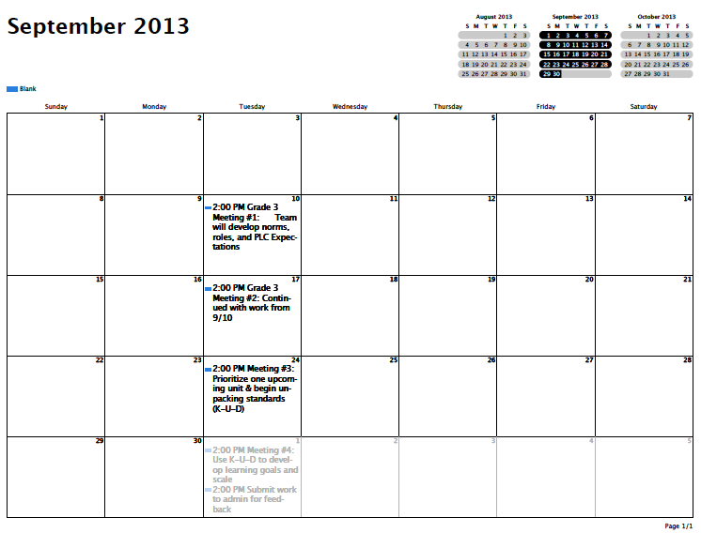
Grade 3 Plan for PLC Collaborative Work
Grade Level PLC #1
Grade Level PLC #2
Grade Level PLC #3
Grade Level PLC #4

Slide 89
PLC Action Planning

Slide 90
End of Day Activity
Identify your next four PLC meetings
With your processing partner, discuss what the topics for these meetings might cover
Write out what topics you are going to cover
Write out your next meeting’s agenda (including how you’ll cover the content)
Use your peers for feedback
Email your work (PDF and/or Doc) to dsanchez@pasco.k12.fl.us with the subject heading “PLC Action Plan”

