Slide 1
Welcome! PLC Facilitators Training
Day 1
Empowering Collaborative Teams

Slide 2
Opening Discussion
“We believe that teachers are professionals and engineers of teaching and learning…we need to set course on a new journey that extends our past learning. A journey that ignites empowerment and professionalism in Pasco County.”
http://www.youtube.com/watch?v=xFs8P_TrAVQ
Notes:
Discuss Empowerment

Slide 3
Norms for Our Work
If you think it, say it
Ask questions
Take care of your neighbor
Take care of yourself
What is said here stays here; what is learned here leaves here
Be present

Slide 4
Review of Materials
Materials to Bring
Provided Materials
PLC Infrastructure Work
Completed PLC Rubrics
Master Schedule
Assessment Map (if applicable)
School Improvement Planning Worksheets (Title 1)
School Beliefs, Mission and Vision Statements
Participant Notebook
PPT Handout
Notes:
The PLC infrastructure work is what administrators are bring from leadership week
The Completed PLC Rubrics are what administrators should have completed. There should be one per school
Master schedule will assist when we start looking at scheduling for adult collaboration
Assessment map will assist when discussing Step 0 common assessments
SIP worksheets were completed by Title 1 schools for planning how they spent Title 1 funds.
The participant notebook is intended to provide larger copies of important slides, and also a place for folks to write notes for some activities.
Have teams locate their materials (2 minutes)
Here is where you can also do housekeeping.

Slide 5
Setting up your Facilitator Group As a PLC (Introductions)
Take a few moments to introduce yourself to your team
Name/Role
Where did you graduate from?
Summer Plans?
School Introductions (1-2 minutes each)
School Name
Demographics
Any other item of interest
Notes:
Purpose for this activity is to set up PLCs for the facilitator’s team. We are modeling how we want them to work with their grade level teams.
5 Minutes for step 1

Slide 6
Setting up your Facilitator Group As a PLC (Roles)
Who will be your facilitator of conversations?
Who will take notes and manage your materials?
Who will be your time keeper?

Slide 7
Setting up your Facilitator Group as a PLC (Norms)
What will your norms be for your work today and for follow-up meetings?
Do you need to make revisions to the large group norms?

Slide 8
Setting Up Process Partners
Find someone seated near you who will be your “summarizing” partner for this training.
Make sure you partner with participants from the same grade level/content area in your school if applicable.
Notes:
This is who you can have folks process information with if you need to enact on the spot.

Slide 9
End In Mind
Notes:
Process activity: Examine KUD and Learning Scale.
This was developed as a collaborative activity in which folks who run and participate in PLCs thought of all of the knowledge, skills and understanding that PLC facilitators need. You’ll notice that we focus on Professional Learning Communities, but this sets within other district priories of professional growth and standards-based instruction. This is a multi-dimensional KUD. That means that it includes more than one skill/understanding and knowledge base to develop. Facilitating is complex.
Please identify this slide In your participant notebook. Please highlight under the know…Definition of PLCs, Step 0, and Effective facilitator techniques. Under the understand, please highlight the purpose of….and how PLC work integrates all district focus areas….and under the do, please highlight PLC infrastructure plan. These represent our end in mind knowledge for today.

Slide 10
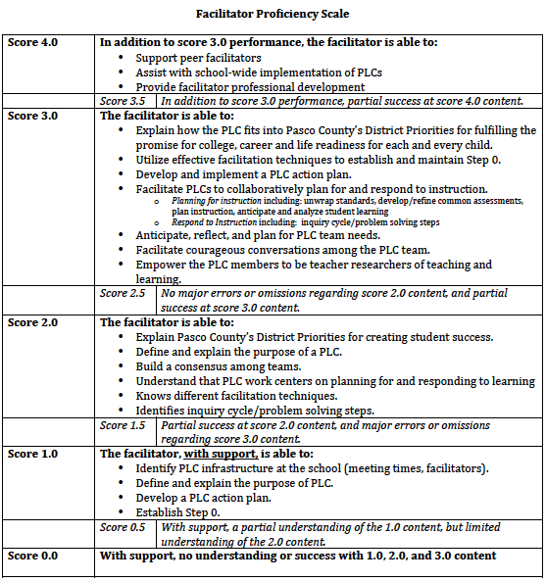
Notes:
Here is our scale for learning for our two day facilitator’s training. We developed this from our KUD to allow for participants to understand where they are relative to… There are likely things on here that you know, and can already demonstrate. There are also skills represented here that you have no background knowledge, and that is fine. That is what this training is for!
Process Activity on next slide

Slide 11
Activity #1: Pre Rating and Sharing
Independently:
Rate (by highlighting) where you are on the “Facilitator Proficiency Scale”
Note: This training is designed to prepare you for a Rating of “2”. Ratings of 3+ require practice implementing!
Indicate an area that is a strength for you
Share with your process partner
What are the key differences among 2, 3 and 4 ratings?
Why are you here at this training?
What is your role?
Notes:
This Pre rating should take 10 minutes.
We will revisit this after our training to celebrate new knowledge, understanding and skills.

Slide 12
PLC Facilitator’s Training Learning Map Goal for this Unit: Develop and Implement PLCs to Support District Focus Areas
PLC Facilitator Training Day 1 | PLC Facilitator Training Day 2
Introduction and Background Pasco’s Multi-Year PLC Plan Connections to Objectives/Priorities and Mission/Values How PLC work integrates all district focus areas PLCs Definition of PLCs; Key Terms Purpose of PLC work 5 Questions that drive PLCs Inquiry Cycle Step 0 for PLCs PLC infrastructure planning Organization of Teams/Meeting Structures Norms/Roles Climate/Culture Scheduling/Protective Time Establishing and Communicating Clear Expectations Common Assessments/Assessment Mapping Effective Facilitation Techniques Characteristics of a Professional Facilitator | Review of Previous Work Purpose of PLC work Facilitation Techniques 5 questions that drive PLCs What do we want all students to learn? (Unpacking Standards, Creating Learning Goals and Scales) How will we know if and when they have learned it? (Scales/Rubrics) How will we teach it? (Prioritized instructional practices, Marzano Connections, Prioritized Shifts) How we will respond if some students do not learn and How will we respond if the students have already learned? PLC Action Plan Development Step 0 with Grade/Content/Subject Teams PLC driving Questions with Grade/Content/Subject Teams Facilitator Support Plan
DQ #1:
Notes:
This represents our learning map.

Slide 13
Day 1: Key Content and Learning Goals
Introduction and Background
PLCs
Step 0 for PLCs
Effective Facilitation Techniques
Unit Learning Goal: Develop and implement PLCs to support CCSS, Professional Learning, and Professional Growth
Today’s Learning Goal:
To develop/refine and communicate your PLC Infrastructure plans
Notes:
Here is an outline of our information today, and our specific learning goals. The UNIT goal will likely be multi-year. We want to develop your capacity to support changes, particularly in standards and professional growth.
However, for today, we are working on how to get started, or make what you are already doing stronger.

Slide 14
Setting the Context and Focusing our Lens
Our new journey will lead us to shared leadership, shared decision-making, and reciprocal accountability.
Notes:
This section is our “Why” section for PLCs and why we are focusing on PLCs.

Slide 15
Building our “Why”
"There are leaders and there are those who lead. Leaders hold a position of power or authority, but those who lead inspire us. It's those who start with…
"Why"
…that have the ability to inspire those around them.
People don't buy what you do, they buy why you do it.”
Notes:
We want to move beyond telling people what and how. We want to inspire with Why.

Slide 16
PASCO’S INTEGRATED SYSTEM: Why
The WHY: Fulfilling the Promise College, Career, and Life Readiness for Each and Every Student
Why?
Notes:
Our compelling why, as educators, is to fulfill our promise to children. That they can and will be ready for life and have options, and that the educational experiences that we provide will empower them to have those options. This will strengthen our communities, it will empower our families and it will create a future that is led by the very students we educate now. It really comes down to why you decided to become an educator. It comes down to why you are still an educator. It comes down to why you get up every morning to go to work, and why you are here today in June/July which is for many of you a summer break. We must believe that our purpose for working is student success. And we must believe that we are essential in making that happen.

Slide 17
PASCO’S INTEGRATED SYSTEM: What
MTSS: One Integrated Framework
Standards-Based Instruction
Professional Growth System
*CCSS
and
NGSSS
Effective Instruction
and
Leadership
PLC
What?
Professional Learning
Notes:
Lacey
So how do we get there? First way is by developing and supporting our people. I am deeply committed to developing and collaborating with our stakeholders. Together we will build a professional growth system to elevate and improve the teaching profession. In order for teaching practices and student outcomes to improve, teachers have to play a main role in holding their colleagues responsible and helping them get better.
And it is not just about individual success. It’s about team success. That’s why we are committed to building strong professional learning communities.
Later, you will hear more about our plan for CCSS implementation system. The bottom line is that a well-trained and highly supported work force will better be able
to serve our students and provide the interventions and guidance they need to be successful.

Slide 18
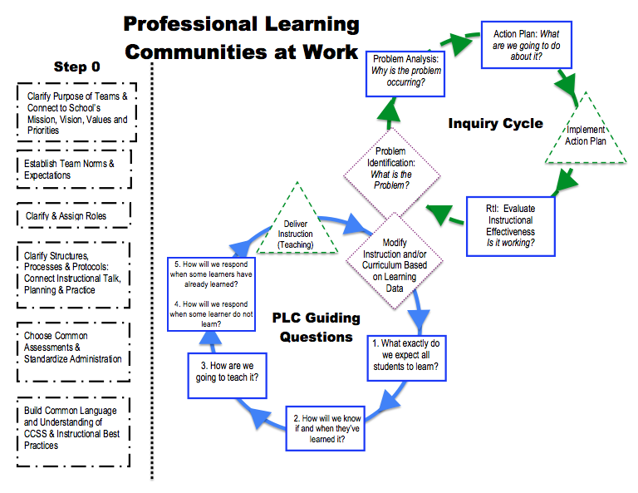
PASCO’S INTEGRATED SYSTEM: How
How?
Notes:
We are going to unlock our why by investing in our greatest resource, teachers. We have untapped potential when we work together. We want to move away from developing individuals….not because we don’t or didn’t have good intentions. But, we missed out on a huge opportunity to tap our collective capacity to learn from each other. You’ll notice that this is our first slide that talks about professional learning communities. Most of our work for the next two days will focus on how we will create/build/refine our Professional Learning Communities to support our focus areas. We will revisit this graphic later and talk much more about it. But remember, as we create these systems, as we invest our time and energy, do not forget the why. We are doing this for an intended outcome. But we can’t do it alone. It’s beyond what one person can do. We need to work together.

Slide 19
2012 FCAT 2.0: Implications for Pasco (Source: http//fcat.fldoe.org)
Reading | 3rd | 4th | 5th | 6th | 7th | 8th
% of Pasco Students 3 and Above / (State Average) | 57% (56%) | 62% (62%) | 59% (61%) | 59% (57%) | 61% (58%) | 55% (55%)
% of Pasco Schools BELOW State Average 2012 | 52% | 57% | 61% | 60% | 47% | 60%
% of Pasco Schools BELOW State Average 2011 | 59% | 54% | 50% | 53% | 47% | 53%
Math | 3rd | 4th | 5th | 6th | 7th | 8th
% of Pasco Students 3 and Above (State Average) | 50% (58%) | 55% (60%) | 53% (57%) | 51% (53%) | 54% (56%) | 52% (57%)
% of Pasco Schools BELOW State Average 2012 | 72% | 65% | 61% | 67% | 67% | 73%
% of Pasco Schools BELOW State Average 2011 | 70% | 67% | 70% | 73% | 67% | 60%
Writing | 4th | 8th | Science | 5th | 8th
% of Pasco Students 3 and Above / (State Average) | 77% (81%) | 77% (78%) | % of Pasco Students 3 & Above / (State Average) | 46% (51%) | 44% (46%)
% of Pasco Schools BELOW State Average | 65% | 53% | % of Pasco Schools BELOW State Average 2012 | 63% | 73%
 |  |  | % of Pasco Schools BELOW State Average 2011 | 74% | 60%
Notes:
STANDARDS WENT UP FOR THE ENTIRE STATE—NOT JUST PASCO - 2011 AND 2012 TESTED THE NEW STANDARDS USING FCAT 2.0
2011 Reading and Mathematics results were reported on a scale that was equated to the 2010 FCAT ensuring similar statewide results between the 2010 and 2011 school years. This year, the scores are reported using the new scale developed specifically for the FCAT 2.0.
PERCENTAGE OF SCHOOLS SCORING BELOW THE STATE AVERAGE: COMPARISON OF 2011 AND 2012
READING 2012 RESULTS - MORE SCHOOLS SCORING BELOW THE STATE AVERAGE IN 4TH , 5TH, 6TH AND 8TH
READING 2012 RESULTS – GRADE 5 SCORED BELOW STATE AVERAGE
MATH 2012 RESULTS - MORE SCHOOLS SCORING BELOW THE STATE AVERAGE IN 3RD AND 8TH
MATH 2012 RESULTS – GRADES 3 THROUGH 8 SCORED BELOW STATE AVERAGE
WRITING 2012 RESULTS – GRADES 4 AND 8 SCORED BELOW STATE AVERAGE
SCIENCE 2012 RESULTS - MORE SCHOOLS SCORING BELOW THE STATE AVERAGE IN 8TH
SCIENCE 2012 RESULTS – GRADES 5 AND 8 SCORED BELOW STATE AVERAGE

Slide 20
So, where are we?
Over the last few years:
Reading: over 40% of students enter 9th grade below proficiency
Math: over 40% of students enter 9th grade below proficiency
Black: over 50% of our black students score below proficiency in reading and math
Poverty: over 40% of our low SES score below proficiency in reading and math
Reading: only 30% of our students score in the highest levels
Math: only 31% of our students score in the highest levels
Science: only 10% of our 5th grade students score in the highest levels
Source: FL DOE School Accountability Report

Slide 21
So, where are we?
In 2010, only 48.9% of our Pasco County students scored high enough on college placement tests in math, reading and writing to avoid remedial coursework at the community college level.
In fact, only 48.1% of our students enrolled in a Florida post secondary institution in the Fall of 2010
And of those students, only 73.1% earned a GPA above 2.0 that Fall term.
Notes:
This is not an elementary thing, or a middle school thing, or a high school thing. This is something that we need to work together with a collective investment.

Slide 22
Building and Strengthening our “Why” for PLCs
“Many schools have good teachers, but lack the capacity to raise student achievement because meeting that challenge is beyond the capacity of individual staff”
Marzano and Dufour, Leaders of Learning (2012)
Why?
Notes:
This slide should connect the data to the need for PLCs. Our data is not where we want it to be, and PLCs are a vehicle for school and system improvement.

Slide 23
Building and Strengthening our “Why” for PLCs
PLCs are research-based
PLCs empower teachers through collaboration and increased self-efficacy
PLCs work together to ensure a guaranteed and viable curriculum
PLCs promote intentionality of planning and instruction
Professional Growth/CCSS
Student Outcomes/Learning
Professional Growth/CCSS
Intentional Instruction
Intentional Planning
Notes:
Why do we predict that PLCs will improve learning for all if implemented correctly? More “why” for PLCs

Slide 24
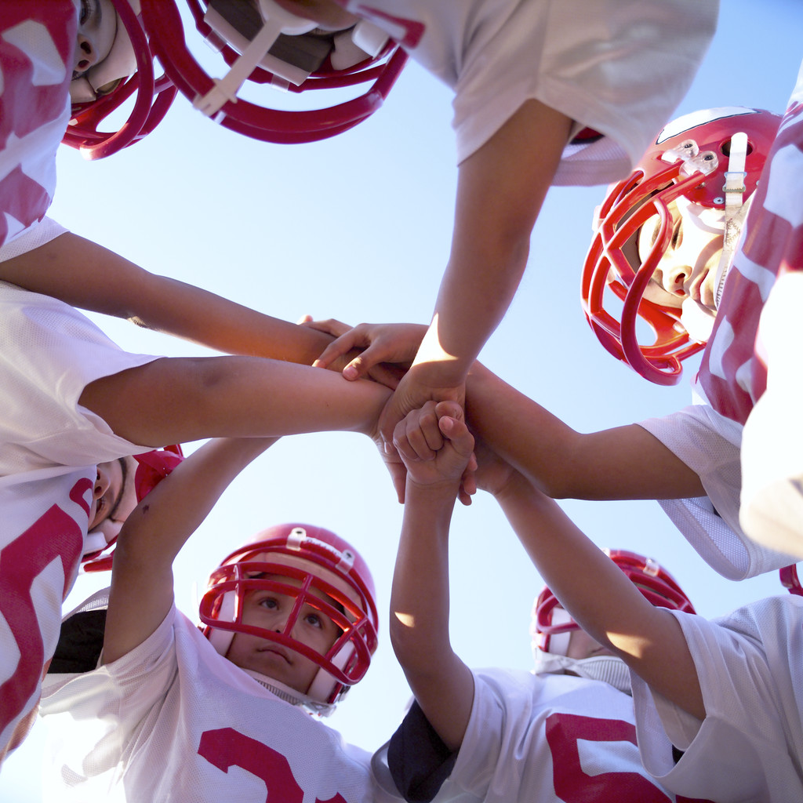
Building and Strengthening our “Why” for PLCs
Why should we invest our time and
resources to build PLCs as a way of work?
2. What are the anticipated benefits?
3. We are all leaders in some way.
How will we “inspire” those around us?
Why?
Notes:
Have teams discuss these questions with their process partners.

Slide 25
Professional Learning Communities Overview
Intentional Student Outcomes/Learning
Intentional Instruction
Intentional Planning
Notes:
Information DQ2 slides. Initial content on PLCs

Slide 26
Building a Common Language
Key Vocabulary:
Professional Learning Communities
Collaborative Planning
Facilitators
Step “0”
5 Questions that drive PLC work
Standards-Based Instruction
Professional Growth System
“If an organization has shared understanding of terms, they will significantly increase the likelihood of implementing PLCs”
-Marzano and Dufour, Leaders of Learning
DQ #2: Critical Information
Notes:
Embedded vocabulary instruction.
Leaders of Learning pg. 36 “Directly teach those terms through description, explanation, and examples; engage staff in discussions of the terms; and periodically assess levels of understanding”
Handout – Portable Activity for School-level PLCs
Activity: Have summarizing pair work to define each key vocabulary term together. Then, give teams time to share their answers with their larger team. Then, ask for volunteers to share their definitions for terms 1, 3, 4, and 5. These are the definitions we will be specifically working with today.
Definitions:
PLCs – on next slide
3. Facilitators – Individuals who facilitate conversations and processes to support group decision making, learning, and discussions.
4. Step 0 – Areas that need to be addressed at the school-level and at the PLC level to support collaborative decision making and discussions. Examples of School-Level Step 0 items are schedules, organization of teams. Examples of PLC level Step 0 items are Norms/Roles
5. The five questions that drive PLC work are (1) What exactly to do we want all students to learn, (2) How will we know when and if they have learned it?, (3) How will we teach it? (4) What will we do if some students do not learn? And (5) what will we do if some students have learned?

Slide 27
Professional Learning Communities (PLCs): Defined
Professional learning communities are
“Educators committed to working collaboratively in ongoing processes of collective inquiry and action research in order to achieve better results for the students they serve” – Dufour, Dufour, Eaker & Many (2011)
Notes:
This is an example of a definition for PLCs

Slide 28
Three Big Ideas for PLCs
http://www.youtube.com/watch?v=7-ErgtGzkhs
Notes:
Rebecca DuFour video on the three big ideas

Slide 29
Professional Learning Communities: Big Ideas
Focus on a Collaborative Culture
Focus on Learning for All (Students and Adults)
Focus on Results
DQ #2: Critical Information
Notes:
These are the three ideas that DuFour talked about.

Slide 30
PLCs: A Fundamental Shift
Shift Happens
DQ #5: Enthusiasm
Notes:
Wait for it…
In order to enact our big ideas, we need to look at how we work together and how understand student learning, and how we teach.

Slide 31
Understanding our Past
In the 80’s, as a results of “A Nation At-Risk”, decision-making was decentralized, decisions were all up to the LEA and schools, but with no structure to support this change.
In the 90’s-00’s, as a result of NCLB, decision-making was centralized, the DOE and the FDOE made decisions, but with no structure to support this change.
Now: Lets create the structure to support what we want…respect, empowerment and student achievement.
Notes:
Why this shift?
When reflecting on the past reform efforts, reformers did not consider the structures that schools were working within. Our present reform is considering the structure first and then layering in the change initiatives.

Slide 32
Activity #2: PLC Shifts
Review the Handout “Cultural Shifts in a PLC”.
Divide your team into 3-4 person groups. Each group should review and process one of the following Cultural Shifts
- Shift in Fundamental Purpose
- Shift in the Work of Teachers
- Shift in School Culture
- Shift in Professional Development
Prepare to share with your facilitator team
- What is the key understanding of this shift?
- How would your shift impact collaboration for teams?
Select and Share:
- Which is the most important shift for your school?
DQ #3: Deepening Knowledge
Notes:
Utilize handout “PLC shifts” Purpose of this activity is to understand the changes required to implement PLCs as a way of work.

Slide 33
Notes:
The purpose of this slide is to promote laughter.

Slide 34
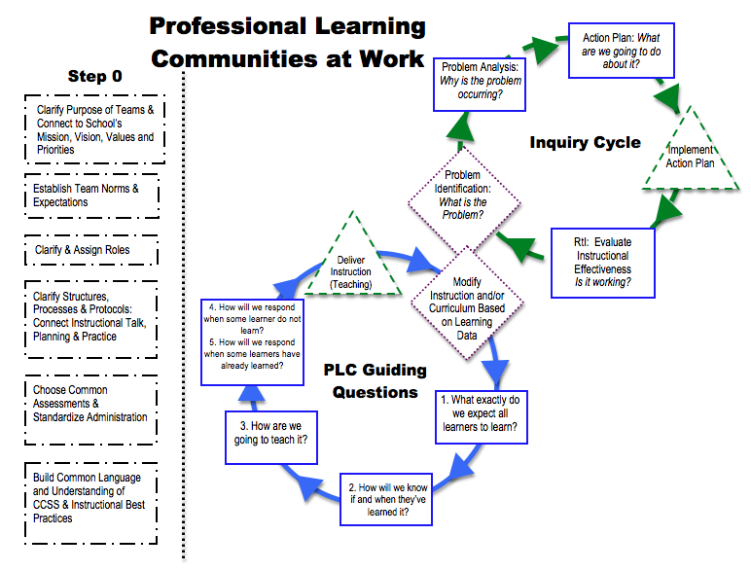
What is the “Right” Work

Slide 35
Activity #3: What is a Professional Learning Community?
Think of these three words: professional, community, learning. What visual representations (non linguistical) do you have for each of these words?
Describe your pictures to the group
DQ #2: Recording and Representing Knowledge
Activity option #1
Notes:
Two options for activities: Nonliguistical and a Frayer model. Teams can select which activity they’d like to select.

Slide 36
Activity #3: What is a professional learning community?
Create a Frayer Map as an individual.
- You have 2 minutes to complete solo
After this, pair with your processing partner and take 5 minutes to add to your summarizing partner’s maps to have a more complete description of PLCs
After this, take 3 minutes and share with another pair
DQ #2: Recording and Representing Knowledge
Activity Option #2
Notes:
Did anyone’s partner have something different?
Did anyone’s table have other thoughts to add to your Frayer?

Slide 37
Definition
Big Ideas
PLC
Examples
Non-Examples
Notes:
Secondary

Slide 38
Step 0: Strengthening our Foundation
Quality PLCs just happen for a small percentage of lucky educators.
For the rest of us, there is Step 0
Mini Lesson Goal: Develop/refine and communicate your PLC Infrastructure plans

Slide 39
Step 0: Building our Foundation

Slide 40
Step 0: Building our Foundation
In order to implement PLCs, you need to develop key pieces of infrastructure:
Build a “Compelling Why” for PLCs among staff
Organize staff into meaningful teams
Schedule protected time for meeting
Clarify the Work PLC teams will Accomplish
Create/Refine Common Assessments
Build your Collaborative Culture

Slide 41
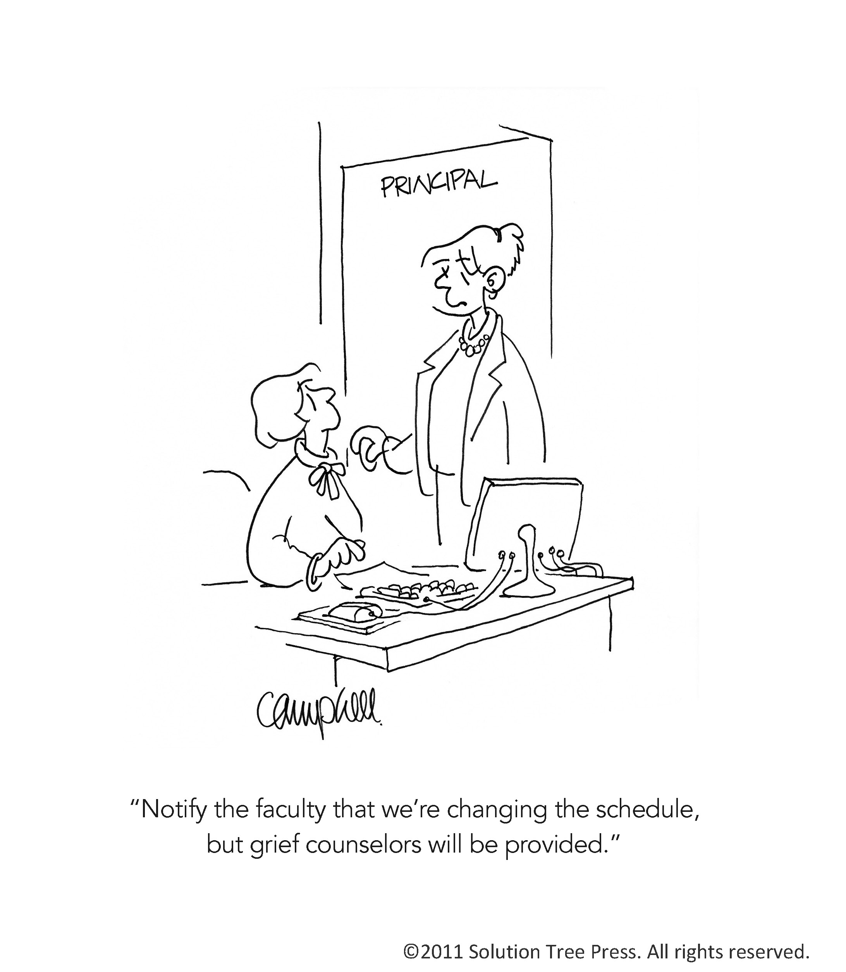

Slide 42
Activity #4 A-E Step 0: Building our Foundation Workshop
We will review the 5 pieces of infrastructure
Organization of Teams
Scheduling Time to Collaborate
Clarify PLC Work
Common Assessments
Collaborative Culture
After our review, pick up to three that you will explicitly work on today with your Facilitator’s PLC team.
You will be given three 15-20min intervals for work
Prepare to share your work visually to your peers
You will then provide and receive feedback from other teams on your work.

Slide 43
Activity #4 A-E Step 0: Building our Foundation Workshop
We will review the 5 pieces of infrastructure
Organization of Teams
Scheduling Time to Collaborate
Clarify PLC Work
Common Assessments
Collaborative Culture
After our review, pick up to three that you will explicitly work on today with your Facilitator’s PLC team.
You will be given three 15-20min intervals for work
Prepare to share your work visually to your peers
You will then provide and receive feedback from other teams on your work.

Slide 44
Organization of Teams/ Meeting Structures
“The Bottom Line: Organize the teams in a way that will produce the best results for the students rather than the one that is most familiar and comfortable...”
- A Facilitator’s Guide to Professional Learning Teams
Notes:
Beyond the capacity of just the principal, coaches, one teacher. It takes working together. And, if you want to work together well, you need to be organized in a way that promotes conversations about the right things.

Slide 45
Team Structure Overview
Team Structures | Description
Same course/content or grade level teams | Teams share similar standards and content. Examples: 4th Grade; 6th Grade Math; Geometry Team
Vertical Teams | Teachers who teach content above and below their students
Electronic Teams | Utilize technology to collaborate and share ideas
Interdisciplinary Teams | Teams that work together for over-arching school-wide goals. Ex: Teams focusing on Writing across Content Areas/Courses
Logical Links | Teams that work together on common professional development goals. Teams may or may not teach similar content.
Adapted from
Leaders of Learning 2012, Marzano and Dufour
Notes:
These are ways in which teams can be potentially organized. One thing to keep in mind is that if one of our focus areas is CCSS, then we will need to make sure that CCSS are integrated into PLC conversations. Some of these team structures are more applicable for CCSS implementation.

Slide 46
Activity 4a: Organization of Teams
Discussion: What is the intended benefit or outcome of organizing our staff into meaningful learning teams?
Decision: Are you creating, refining, and/or communicating your PLC team organization?
Action:
Review examples of PLC team organization
If you are creating:
What organization of teams will best serve for PLCs as a vehicle for CCSS implementation and Professional Growth?
If you are refining:
Will your team organization plan lead you to your intended benefit?
What changes, if any, are needed?

Slide 48
Step 0: Scheduling Protected Time
“We don’t have the time to collaborate”
-School-Board of Pasco County Teachers and Staff 1876-2013

Slide 50
Activity 4b: Scheduling Protected Time
Discussion: What is the intended benefit or outcome of scheduling protected time?
Decision: Are you creating, refining, and/or communicating your scheduled protected time?
Action:
Review resources for scheduling
If you are creating:
What schedule will allow us to authentically collaborate?
If you are refining:
Will your scheduled protected time plan lead you to your intended benefit?
What changes, if any, are needed?

Slide 51
Step 0: Clarifying Expectations for PLC Work
The critical question in a PLC is not, “Do we collaborate” but rather, “What do we collaborate about?” You must not settle for “Collaboration Light.”
-Dufour and Dufour, 2010

Slide 52
Activity 4c: Clarifying Expectations for PLC Work
Discussion: What is the intended benefit of clarifying expectations for PLC work?
Decision: Are you creating, refining, and/or communicating your expectations for PLC work?
Action:
Review examples of PLC work expectations
If you are creating:
What do you want PLCs to really look like?
What would it sound like? What are examples? And what are non-examples?
If you are refining:
Will your clarifying expectations plan lead you to your intended benefit?

Slide 53
Step 0: Common Assessments
How will we know if students are learning what we want them to learn?

Slide 54
Characteristics of Common Assessments
Measure essential student learning (includes formative and summative uses)
Generated/created by teachers
Clearly defined essential understanding and student performance outcomes exist for every unit of instruction
Include all students taking the same course or grade level assessment across classes/teachers
Administered in a systematic and timely manner
Allows for analysis of results within PLC
Item analysis is planned and occurs immediately following each assessments
Clearly defined assessment criteria exist

Slide 55
Characteristics of Embedding Common Assessments
Assessment for Learning/Common Assessment Prompts
How can student demonstrate proficiency as the lesson is being taught?
Rubrics and Scales (Marzano)
How can we utilize common student friendly scales to assess essential student learning?

Slide 56
Mapping Assessments Activity
Map out your Tier I assessments
What assessments?
When given?
How data is organized for decision-making?
Given to who?
How is it used?
Notes:
Optional Activity

Slide 57
Assessment Map Example
Assessment | When Given | Given to Whom | Admin Procedures
Reading Pre/Post Assessments | 10/1-10/7 11/14-11/19 12/10-12/15 1/30-2/5 3/1-3/6 4/14-4/19 | All Students | Computer-Based
Formative Reading Assessments Prompts, Work Sample Performance Tasks | TBD based upon PLC discussions | All Students | Embedded within instruction
Math Pre Post Assessments | Every 5 weeks | All Students | Students take pre tests during third week or prior chapter test. Test is given whole group
Notes:
Have participants stop and process this slide

Slide 58
Activity 4d: Common Assessments
Discussion: What is the intended benefit of common assessments?
Decision: Are you creating, refining, and/or communicating your common assessments?
Action:
Review examples of Common Assessments Maps
If you are creating:
Make a plan to complete a common assessment map
Consider what stakeholders you will need at the table
Consider this work for your PLCs
If you are refining:
Will your common assessments plan lead you to your intended benefit?

Slide 59
Step 0: Creating a Collaborative Culture
PLCs are more than just schedules and meetings.
Do people actually want to participate?

Slide 60
Activity 4e: Creating a Collaborative Culture
Discussion: What is the intended benefit of creating a collaborative culture?
Decision: Are you creating, refining, and/or communicating your collaborative culture?
Action:
Review your School-Wide Culture Items #26-31
Read “A Shift in School Culture” (3 pages), and Review the “Shifts” handout
If you are creating:
How will you make your PLCs something that people want to attend because it helps them?
What factors are holding your teams back for creating a collaborative culture?
If you are refining:
Will your collaborative culture plan lead you to your intended benefit?
What changes, if any, need to be made?

Slide 61
Activity #4 A-E Step 0: Building our Foundation Workshop
We will review the 5 pieces of infrastructure
Organization of Teams
Scheduling Time to Collaborate
Clarify PLC Work
Common Assessments
Collaborative Culture
After our review, pick up to three that you will explicitly work on today with your Facilitator’s PLC team.
You will be given three 15-20min intervals for work
Prepare to share your work visually to your peers
You will then provide and receive feedback from other teams on your work.

Slide 62
Activity #5: Gallery Walk for Forward Planning
Feedback Role
Sharing Out Role (1-2 per team)
Revisit and update any of your step 0 items, as needed
Prepare to share your plan with the larger group
Organization of Teams
Schedules
Expectations for PLC work
Common Assessments
Collaborative Culture
As teams present provide feedback using sticky notes
2 positive feedback (e.g., I like how you….)
1 considerations/suggestions (e.g., have you considered…?)

Slide 63
Gallery Walk Debrief
Review Feedback
What feedback did you receive from other teams?
Review other teams’ ideas
What ideas did you see from other teams that may be helpful for your school?
Remember your roles and norms!
Facilitator, Note Taker

Slide 64
Looking Forward

Slide 65
Are You Part of a Professional Learning Community?
A Professional Learning Community is NOT:
A program to be implemented
A package of reforms to be adopted
A step-by-step recipe for change
A sure-fire system borrowed from another school
One more thing to add to an already cluttered school agenda
A PLC IS a way of work that will change a school’s culture!

Slide 66
Why have past initiatives failed?
Failure to achieve consensus
School culture is ignored
Purpose unclear
Lack of ongoing communication
Unrealistic expectations of initial success
Failure to measure and analyze progress
Participants not involved in planning…
Notes:
Emphasize the need for a consistent and well communicated vision which will facilitate consensus. As well, when individuals are part of the planning process and are able to have input over how the initiative is implemented, buy in is enhanced.

Slide 67
Activity #6: Team Reflection, Anticipating Barriers
What are some potential barriers to implementing PLCs in your school?
Rate those barriers using a scale from 1-10
Select top 3 barriers
Discuss what would be likely causes for each barrier
Discuss ways you can overcome these barriers (preventative actions)
Record your team’s action steps/plan to address your top 1-3 barriers on your Participant Notebook
Notes:
This is very, very light potential problem analysis
What are some potential barriers to implementing PLCs at your school? (predict potential problems)
Rate those barriers using a scale from 1-10 (use a higher or lower scale as needed)
Select top 3 barriers
Discuss what would be likely causes for each barrier (potential problem analysis)
Discuss ways you can overcome these barriers (preventative actions)
Record thoughts and next steps in your note taking guide .

Slide 68
PLC Facilitator’s Training Learning Map Goal for this Unit: Develop and Implement PLCs to support CCSS and Professional Growth
PLC Facilitator Training Day 1 | PLC Facilitator Training Day 2
Introduction and Background Pasco’s Multi-Year PLC Plan Connections to Objectives/Priorities and Mission/Values How PLC work integrates all district focus areas PLCs Definition of PLCs; Key Terms Purpose of PLC work 5 Questions that drive PLCs Inquiry Cycle Step 0 for PLCs PLC infrastructure planning Organization of Teams/Meeting Structures Norms/Roles Climate/Culture Scheduling/Protective Time Establishing and Communicating Clear Expectations Common Assessments/Assessment Mapping Effective Facilitation Techniques Characteristics of a Professional Facilitator | Review of Previous Work Purpose of PLC work Facilitation Techniques 5 questions that drive PLCs What do we want all students to learn? (Unpacking Standards, Creating Learning Goals and Scales) How will we know if and when they have learned it? (Scales/Rubrics) How will we teach it? (Prioritized instructional practices, Marzano Connections, Prioritized Shifts) How we will respond if some students do not learn and How will we respond if the students have already learned? PLC Action Plan Development Step 0 with Grade/Content/Subject Teams PLC driving Questions with Grade/Content/Subject Teams Facilitator Support Plan
DQ #1:
Notes:
This represents our learning map.

Slide 69
Facilitation Skills Training 101
Mini Lesson Goal: Know and practice effective facilitator’s skills

Slide 71
Characteristics of Effective Facilitators
Sets location and times of meetings
Prepares necessary paperwork and data ahead of time
Facilitates movement through planning steps and see the “bigger picture”
Ensures participation from team members
Follows up on action plans and communicates with administration

Slide 72
Team Processes: Two Approaches
Task Oriented
Get things done
Ignore feelings, emotions, personalities
Is typically disliked
People Oriented
Makes people happy
Lets feelings, emotions and personalities take over
Is typically liked

Slide 73
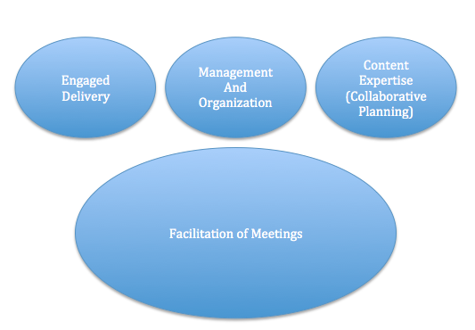
1
2
3

Slide 74
First Body of Knowledge
Engaged Delivery

Slide 75
Communication Skills
Listening
Summarizing
Questioning
Paraphrasing
Delivering
Integrating
Empathizing

Slide 76
Dialogue Techniques
Two-way communication
Provides for deeper understanding
Allows for uninhibited discussion

Slide 77
Substitute “and” for “but”
Substitute “and” for “but” to encourage open dialogue
Keeps discussion value neutral
Allows for both parties thoughts to be heard
Using “but”
Stifles open dialogue; shuts down communication
makes value judgment
may be interpreted as “I don’t care.”
Examples
“Your intervention design is innovative and I have a few suggestions…”

Slide 78
Effective Interpersonal Strategies
Use “I” messages
Seek consensus-not disagreement
Redirect (e.g., “I think that is important and perhaps we can wait…..”)
Ask others for suggested strategies
Reinforce desired contributions
Data feedback to demonstrate effectiveness

Slide 79
Ask a Question
Ask questions to increase levels of understanding
Use questions that focus on the objective
Value neutral
Phrase open-ended questions; a full answer provides a full story
Examples
“What are some reasons you think this happened?”
“How did you reach that conclusion…?”
“Why do you think that would be a good approach?”
“Yes, that is one way. Can you think of another approach?”
“How can we explain differences in what we planned and what occurred?

Slide 80
Reflective Listening
Use Reflective Listening to cut through communication
barriers and filters
Restate
“I think I understand your points. You believe…”
Paraphrase
“So in other words, you are not certain we are all
following the standards we said we would.”
Summarize
“Let’s recap…You can do…I can do…”
At this point, you are planning to…what?
What “a-ha(s)” have you had?
What do you plan to try again? What will you do
differently?
So your next steps will be….what?
Let’s see- you plan to…What other support is needed?
Notes:
According to research, we understand only about one-half of what we hear.
After a period of two months we recall only about one-quarter of what we
heard. This is particularly discouraging when we realize that we spend 70
percent of every day in verbal communication and, of this, we spend 45
percent listening.
Although there are many reasons for ineffective listening, there’s one major
reason for it: poor listening habits. We acquire most of these habits
through daily casual conversation where habits of critical and comprehensive
listening aren’t required. If we’re constantly critical or if we attempt to
retain everything we hear, we’re undertaking the impossible. On the other
hand, if we understand that effective listening is acquired and not inherited,
we may seek to acquire certain specific techniques that offer improvement.
There are no quick and easy answers but the following techniques may get
you started.
DECIDE ON YOUR PURPOSE FOR LISTENING.
Are you listening for enjoyment, to discriminate between ideas or
approaches, to learn information, to act as a sounding-board to a friend, or
to critically evaluate and judge? All of these are good reasons to listen but
will require different listening attitudes. Your purpose will usually be
determined by your priorities at the time.
It is hard to listen critically or to listen for learning when you’re rushed or
under stress. You may need to control your listening environment when
listening effectiveness is critical. For instance, if you need to pass a course
you should prepare for the listening experience by bringing note-taking
materials and reading assignments, being on time, and arriving with a desire
to learn. It’s common for students to attend classes with the notion that
they will learn by osmosis. They often aren’t aware of the energy and
attention required.
TRY NOT TO ASSUME YOU KNOW WHAT WILL BE SAID BFORE IT
IS SAID.
We often develop bad habits of not listening because we assume it will be of
no interest or use to us. We also make prior judgments about the amount of
resistance or approval we will get from someone. With these prior notions
we act without hearing or waiting to hear the speaker. We could improve our
listening skills significantly by exercising patience and, even if we think we
know what will be said, allow the speaker to finish.
TRY NOT TO LET YOUR BIASES CONTROL YOUR LISTENING.
We all have certain prejudices and stereotypes that influence how we
receive speakers. You may refuse to listen to someone because they are
overdressed, foreign, overweight, too loud, too old, or even because they’re
opinionated. Attitudes such as this affect our listening habits by making us
defensive and argumentative, or cause us to shut them out altogether.
TRY TO MONITOR YOUR LISTENING THROUGH FEEDBACK.
Whenever possible, ask clear and thoughtful questions. If these questions
are asked in the right spirit the speaker has an opportunity to repeat,
expand, or clarify his or her message. Remember that you’re the other half
of the communication process and your reactions are critical to producing
good communication for both you and the speaker.
LEARN TO LISTEN FOR THE SPEAKER’S PURPOSE.
This purpose may be stated or unstated. It’s the basic reason the speaker
has for speaking. We often assume early on that some speakers don’t know
why they’re speaking. Often this is true but lets not be took quick to judge.
I have often found that a speaker who has some difficulty getting started,
or who was a little disorganized, might recover and provide worthwhile
information. Concentrate on what the speaker states as a purpose rather
than what you have supposed is his or her purpose.
DON’T YIELD TO DISTRACTIONS.
Our lives are noisy and confusing but we shouldn’t use this as a convenient
excuse for not listening. We can overcome some of the distraction by
reducing noise and adjusting the listening environment. If we have no
control over the distractions then we must rely on intense concentration to
get as much as possible from the speaker.
WHEN POSSIBLE, TAKE NOTES.
If it is appropriate and it will not be distracting to the speaker, make a few
notes as you listen. This will help you organize and frame the speaker’s
thoughts. It will also give you a reference to refer to at a later date if the
material is technical or complex.
There is no communication skill more important to a leader than listening,
yet many persons aspiring to be leaders neglect this skill. It seems to take
so little effort to hear a speaker’s words, but this isn’t listening. The kind
of practice we need in the techniques listed above will require that we
monitor our habits and actively work to improve them.

Slide 81
Dialogue Techniques for Conflict Resolution
Acknowledge the speaker and be attentive - Don’t defend
Conference prior to a meeting
Seek first to understand then to be understood
Separate the person from the problem
Practice reflective listening
Invite criticism and advice
Stay in a position of curiosity not judgment
Use statements to elicit cooperation
Use ‘I’ statements rather than ‘you’ statements.
Make appropriate eye contact
Avoid assumptions
Indicate that the other party has a good point when point has good merit
Identify areas of agreement with others

Slide 82
Assertive Speaking
Stick to the facts
When describing their behavior, don’t exaggerate, label, or judge
Use “I messages”
“I’d like it if we could look at this graph again.”
Not: “You missed a key point in the data.”
“I’d feel a lot better about our time here if we stayed on topic.”
Not: “We’re off topic again.” or, “We’re wasting time.”
Don’t make assumptions about others’ motives
Look for ways of compromising
Developed By Florida Positive Behavior Support Project

Slide 83
Keeping Teams On Track
“We’ve heard a lot of good thoughts. We’re getting away from our subject. Let’s summarize and move on.”
Comment on the team process: “Even though we agreed to hear everyone out, there’s a lot of interrupting going on. How is that affecting the team?”
Developed By Florida Positive Behavior Support Project

Slide 84
Getting ‘Un-Stuck”
“That’s an interesting point. (Be specific). Now let’s hear from _________.”
“I’m sure you have a reason for your point of view, but I’d like you to try to consider the group’s viewpoint for now.
How could we make this statement less abrasive?
Developed By Florida Positive Behavior Support Project

Slide 85
Moving the Road Blocks
“It sounds like the district’s decision to implement Policy Y makes it more difficult for your team to plan new events. But let’s figure out the best way to work with what we have.”
Then have team identify strengths and assets
Developed By Florida Positive Behavior Support Project

Slide 86
Clarify Objectives
“I think something I might have said sounded like we should be addressing X, but right now we really should be focusing on Y.”
Developed By Florida Positive Behavior Support Project

Slide 87
Meeting Monsters
Overly talkative
Highly argumentative
Rambler
Obstinate/Rigid
Griper/Whiner
Side Conversation
Definitely Wrong
Off the Subject
Silent
Notes:
Refer to meeting monsters handout and go through each one….

Slide 88
Case Study
Case Study 1
Facilitator
Hostile Participant
Other Team Members
Time Keeper
Recorder
As a Algebra 1 Facilitator you have worked hard to build relationships with your team, but you have been receiving hostility from a participant. When discussing Algebra data at a grade level meeting and working through the problem-solving steps, this participant continues to challenge or oppose every intervention idea/action of the team.
As a facilitator, how might you handle this situation?

Slide 89
Case Study
Case Study 2
Facilitator
Team Members
Time Keeper
Recorder
As a Facilitator, you are meeting with your team for the first time to review the purpose of your meetings and to develop Group Expectations/Norms. You explain to the team that throughout these meetings the group will be to collaboratively plan together what curriculum you will cover, and ideas on how to cover those topics. Your team completely refuses. They want to talk about individual students immediately because there is nothing wrong with their instruction within the classroom.
How should the facilitator handle this situation?

Slide 90
Effective Meeting Protocols

Slide 91
Facilitating Meetings
Develop Background Knowledge for Work At Hand
Smaller Workgroup Strategies
Consensus Strategies
Share-out Strategies
Decision-Making Protocols

Slide 92
Second Body of Knowledge of Facilitation Skills
Managing and Organizing

Slide 93
Managing and Organization Skills
Understand and Implement Strategies to Organize and Manage Teams Efforts
Examples:
Design and Share an Effective Agenda
Manage Time
Develop Norms and Roles
Understand and Organize Assessments
Prepare and Manage Evidence of PLC Work
Understand the Direction of the Team

Slide 94
Third Body of Knowledge: Content Expertise
Problem-Solving and Collaborative Planning Models

Slide 95
What is the “Right” Work
Notes:
Key Slide:
Main Point #1: Step 0 is what we have spent most of the day discussing.
Main Point #2: The remaining portions

Slide 96
Collaborative Planning and Problem Solving
Collaborative Planning
Problem-Solving
Planning for learning you want to occur
Looking ahead to activities/assessments
Planning a response to learning that has occurred
Planning activities/assessments based on instructional plan
Backwards Planning
Backwards
Planning
Student Performance
Student Performance
Problem-Solving
Problem-Solving

